Slide 1
Advanced Software Engineering
Lecture 1: Introduction
Shehla Saeed
Notes:
“Welcome to our first lecture on Advanced Software Engineering. Today, we’ll start from the basics of engineering, move into software and software engineering, discuss processes, models, and why software sometimes fails spectacularly.”

Slide 2
What is Engineering?
- Application of science & math
- Design & build solutions
- Solve real-world problems
Notes:
“When you hear the word engineering, what comes to your mind—bridges, machines, robots, or maybe… software?”
Definition: Engineering is the application of scientific and mathematical principles to design and build systems that solve real-world problems.
Example:
Civil engineers build bridges that don’t fall; software engineers build systems that don’t crash (hopefully).

Slide 3
What is Software?
- Instructions + data for computers
- Types:
• System software (OS, drivers)
• Application software (apps)
• Embedded software (IoT, devices)
Notes:
“So, what exactly is software? Is it just the apps on your phone, or more?”
Definition: Software is a collection of programs, data, and instructions that tell a computer how to perform tasks.
Examples:
Microsoft Word (application software)
Windows/Linux (system software)
Database engines like MySQL
“Software is the invisible mind behind the machine. Without it, your phone is just a very expensive brick. Think of system software like the operating system, application software like WhatsApp, and embedded software like the program inside your automatic washing machine.”

Slide 4
What is Software Engineering?
- Systematic approach to software
- Combines engineering + computing
- Focus: reliability, scalability, maintainability
Notes:
“Why can’t we just write code and be done with it? Why complicate things with ‘software engineering’?” “Why do you think software engineering is needed instead of just ‘coding’?”
“Software engineering is about discipline. Anyone can write code.
But to build software for banks, hospitals, or governments, we need systems that are reliable, scalable, and maintainable. This is what software engineering ensures.”
Definition: Software Engineering is the disciplined, systematic approach to designing, developing, testing, and maintaining software.
Analogy: Building software is like building a skyscraper—you need blueprints, processes, and quality checks, not just a pile of bricks.
Example:
A banking system that handles millions of transactions daily requires engineering, not random coding.

Slide 5
Software Process
A framework that describes the activities performed at each stage of a software development project.
A set of activities whose goal is the development or evolution of software.
S/w process activities:
1. Requirements analysis
2. Design
3. Implementation
4. Testing
5. Deployment
6. Maintenance
Notes:
A framework that describes the activities performed at each stage of a software development project.
A set of activities whose goal is the development or evolution of software.

Slide 6
Plan-driven and agile processes
Plan-driven processes are processes where all of the process activities are planned in advance and progress is measured against this plan.
In agile processes, planning is incremental and it is easier to change the process to reflect changing customer requirements.
There are no right or wrong software processes.

Slide 7
Plan-driven process
Definition: A traditional, structured, and heavily documented approach to software development. Everything is planned upfront, and change is discouraged.
Characteristics:
Requirements defined early.
Detailed documentation at every stage.
Sequential phases (fits with Waterfall, V-model).
Strict timelines and budgets.
Strengths:
Works well for projects with stable, well-understood requirements.
Easier to manage in highly regulated industries (aerospace, defense, healthcare).
Weaknesses:
Inflexible—any change is costly.
Long delays before delivering working software.
Example: Developing software for an airplane control system. You cannot just “wing it.”
Notes:
Definition: A traditional, structured, and heavily documented approach to software development. Everything is planned upfront, and change is discouraged.
Characteristics:
Requirements defined early.
Detailed documentation at every stage.
Sequential phases (fits with Waterfall, V-model).
Strict timelines and budgets.
Strengths:
Works well for projects with stable, well-understood requirements.
Easier to manage in highly regulated industries (aerospace, defense, healthcare).
Weaknesses:
Inflexible—any change is costly.
Long delays before delivering working software.
Example: Developing software for an airplane control system. You cannot just “wing it.”

Slide 8
Agile process
Definition: An iterative and flexible approach that emphasizes collaboration, customer feedback, and working software over documentation.
Characteristics:
Requirements evolve over time.
Development is done in short iterations (sprints).
Continuous customer involvement.
Focus on delivering usable features quickly.
Strengths:
Adapts to changing requirements.
Early and frequent delivery of working software.
Encourages teamwork and communication.
Weaknesses:
Can lack documentation, which makes long-term maintenance tricky.
Harder to estimate cost and timeline upfront.
Example: Developing a mobile app startup product, where features shift based on user feedback.

Slide 9
Types of SDLC Models
Waterfall Model
Incremental Model
RAD Model
Spiral Model
Scrum Model
Lean Development Methodology
Extreme Programming

Slide 10
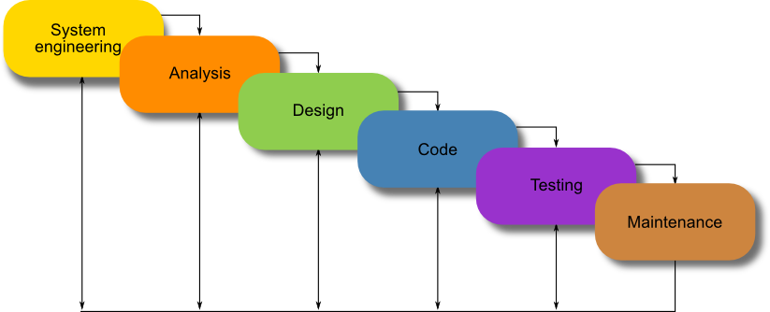
WATERFALL MODEL
.
Notes:
A sequential SDLC model where each phase must be completed before the next begins.
No overlapping phases
Clear documentation
Fixed requirements

Slide 11
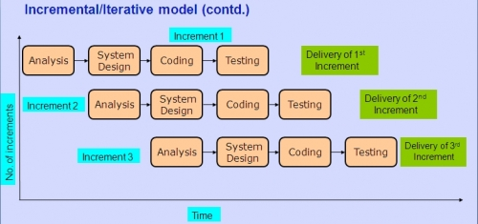
Incremental model
Notes:
A software development approach where the system is developed and delivered in multiple small releases, with each release adding new functionality.
Requirements divided into modules
Each increment goes through full SDLC cycle
Working product delivered early

Slide 12
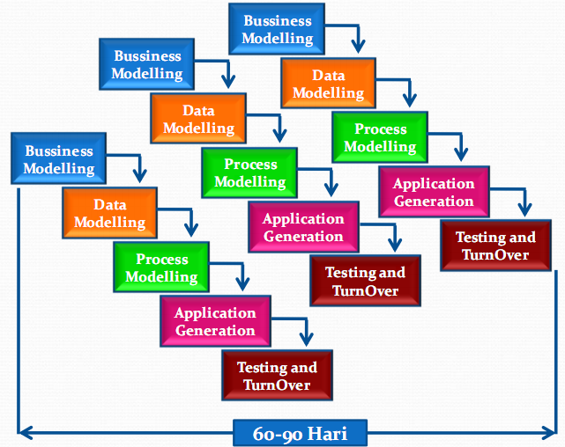
RAD model
Notes:
RAD is an SDLC model that emphasizes fast development, prototyping, and continuous user feedback to quickly produce high-quality software.
Iterative development
Active user participation
Fast delivery
Business Modelling
How the organization works
What information flows between departments
What the business goals are
Data Modelling
What data is needed
Database structure
Relationships between data (tables, entities)
Process Modelling
How data moves
What processes transform it
Workflows and logic
Application Generation
Rapid coding
Use of reusable components
Automatic code generation tools
RAD emphasizes speed. Developers often use frameworks, templates, or CASE tools.
Testing and Turnover
System testing
User acceptance testing
Deployment
User training
Then the next module starts — and the cycle repeats.

Slide 13
RAD model
The phases in the rapid application development (RAD) model are:
Business modeling: The information flow is identified between various business functions.
Data modeling: Information gathered from business modeling is used to define data objects that are needed for the business.
Process modeling: Data objects defined in data modeling are converted to achieve the business information flow to achieve some specific business objective. Description are identified and created for CRUD of data objects.
Application generation: Automated tools are used to convert process models into code and the actual system.
Testing and turnover: Test new components and all the interfaces.

Slide 14
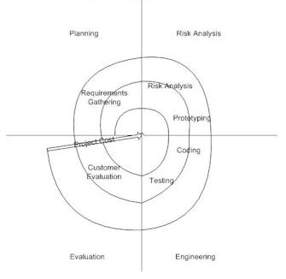
Spiral model
Notes:
The Spiral Model is a risk-driven software development model. It combines ideas from Waterfall (structured phases) and Iterative development (repetition), but adds one powerful ingredient:
Risk analysis at every cycle.
Think of it as building software in loops — and in every loop, you ask:“What could go wrong?”
Risk Analysis
Identify potential risks
Evaluate technical and cost risks
Develop prototypes to reduce uncertainty
This is the heart of the model.
When to Use Spiral Model
Large-scale projects
High-risk systems
New or complex technology
Mission-critical applications

Slide 15
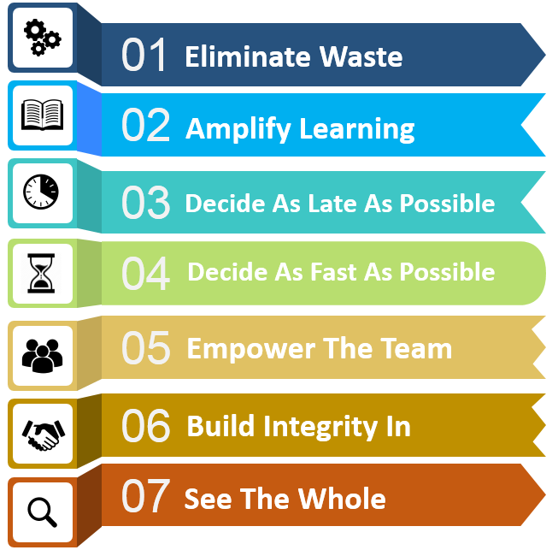
Lean Software Development
Deliver
Notes:
7 Principles of Lean Software Development.
Not exactly a step-by-step model like Waterfall or Spiral. This is more of a philosophy — a mindset borrowed from Lean manufacturing (Toyota Production System) and adapted to software.
Lean asks one uncomfortable question again and again:
“Are we doing something useful — or just staying busy?”
Waste in software is anything that does not add value to the customer.
Examples:
Unnecessary features
Excess documentation
Waiting time
Rework due to poor requirements
Lean says: If it doesn’t create value, remove it.

Slide 16
What are the attributes of good software?
A software product can be judged by what it offers and how well it can be used. This software must satisfy on the following grounds:
Operational
Transitional
Maintenance

Slide 17
Operational
This tells us how well software works in operations. It can be measured on:
Budget
Usability
Efficiency
Correctness
Functionality
Security
Safety

Slide 18
Transitional
This aspect is important when the software is moved from one platform to another:
Portability
Reusability
Adaptability

Slide 19
Maintenance
This aspect briefs about how well a software has the capabilities to maintain itself in the everchanging environment:
Modularity
Maintainability
Flexibility
Scalability

Slide 20
Reasons for Software Failure
- Poor requirements
- Unrealistic deadlines
- Lack of testing
- Scope creep
- Weak management
Notes:
“Why do software projects fail? Usually, it’s not coding errors—it’s poor planning, unclear requirements, and shifting goals

Slide 21
Key Challenges
- Managing complexity
- Rapidly changing requirements
- Security threats
- Balancing cost, time, quality
- Scaling to millions of users
Notes:
“Modern software faces huge challenges:
keeping up with changing needs, staying secure, and scaling.
Imagine the challenge Instagram faces when billions of people open the app daily.”

Slide 22
Closing Thought
- SE ≠ just coding
- Builds scalable, reliable, human-centered systems
Notes:
“Software engineering is about more than just programming.
It’s about designing systems that scale, adapt, and last. The failures you’ve seen in real life are proof of why software engineering matters.”

